Slide 1


New LTER Logo?
assets | liabilities
Solid brand recognition | Inaccurate geography
Recognized history | Static- lacks energy and clear sense of purpose
 | Stylistically dated
 | Trademarked to UNM (solid blue globe)
Notes:
What are you excited about at your site? New experiments, new investigators, exciting papers and studies, new collaborations?

Slide 2
Options
New suite of logos, to include several alternate versions with
Network
Network Communications Office
Tagline (Observe. Inquire. Inform.)
Square and horizontal versions for use on web, social media, and print products
Timing of release to coincide with rebuilt web site, offering opportunity for a major awareness campaign to rebuild brand recognition.
A
B
C
D
E
F
G
H

Slide 3
Rebuild of LTERnet.edu web system
Existing web domains:
Site | Content Management System | Intended Audience
lternet.edu | Drupal 7.50 | LTER Stakeholders/funders/media
intranet2.lternet.edu | Drupal 6.37 | LTER Community
sites.lternet.edu | Not using CMS (DB Admin) | LTER Stakeholders
directory.lternet.edu | Not using CMS (DBAdmin2) | LTER Community
https://bibliography.lternet.edu/ | Not using CMS (DBAdmin) | NSF?
gallery.lternet.edu | Drupal 7.27 | LTER Stakeholders/funders/media
Site | Content Management System | Intended Audience
nco.lternet.edu | Wordpress 4.7 | LTER Community
im.lternet.edu | Drupal v 6.37 | IM Community
news.lternet.edu | Drupal v 6.37 | LTER Community
asm2015.lternet.edu | Drupal 7.5 | LTER Community
asm2012.lternet.edu | Drupal 6.37 | LTER Community
Earlier ASMs | various | LTER Community
https://climhy.lternet.edu/ |  | Data users
https://portal.lternet.edu/nis/home.jsp |  | Data users

Slide 4
LTER Existing Web System
Databases
Drupal 6 Web Sites
Drupal 7 Web Sites
PersonnelDB
(directory.lternet.edu)
LTERNET.edu
Gallery. lternet.edu
SitesDB (sites.lternet.edu)
Intranet2.lternet.edu
Other Web Sites and Resources
BiblioDB
(bibliography.lternet.edu)
im.lternet.edu
NCO.lternet.edu
(Wordpress)
news.lternet.edu
Clim-HydroDB (climhy.lternet.edu)
LTER Science Update (Mailchimp)
ASM2012
Earlier ASMs
Notes:
Web sites in different content management systems, dependent on databases that are difficult to maintain under the current data management structure.

Slide 5
LTER Integrated Web System
Databases
Drupal 6 Web Sites
Drupal 7 Web Sites
Redesigned Site
(D7 or WP)
LTERNET.edu
PersonnelDB
(directory.lternet.edu)
Gallery. lternet.edu
Phase 1
Summer/Fall 2017
Phase 2
Funding dependent
SitesDB (sites.lternet.edu)
Intranet2.lternet.edu
Other Web Sites and Resources
BiblioDB
(bibliography.lternet.edu)
im.lternet.edu
NCO.lternet.edu
(Wordpress)
other committee sites?
news.lternet.edu
Clim-HydroDB (climhy.lternet.edu)
LTER Science Update (Mailchimp)
ASM2012
Archive
Earlier ASMs

Slide 6
Web timeline and process
Proposals
due
Vendor selected
Information
Architecture
Front end
Design
Launch
Discovery
Promote
Build
May
June
July
Aug
Sept
Oct
Nov
EB and Comm Com Review
EB and Comm Com Review

Slide 7
Goals
Principles
Make content easier to find
Make content easier to update
Align content provided with core LTER audiences
Increase visual appeal
SEO-friendly
Responsive design
Accessible for visitors with disabilities
Re-usable content

Slide 8
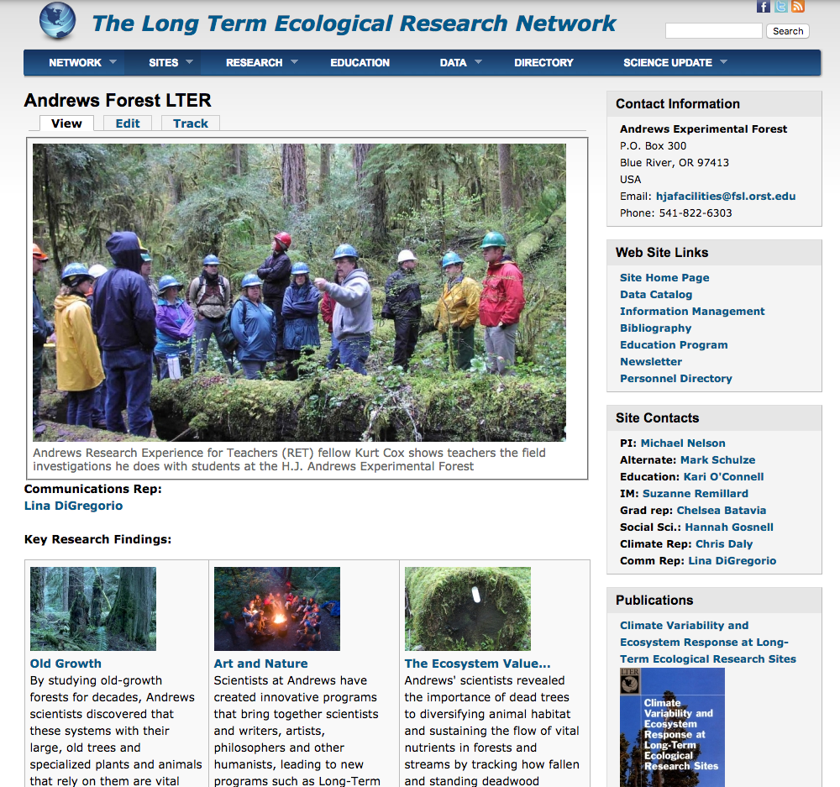
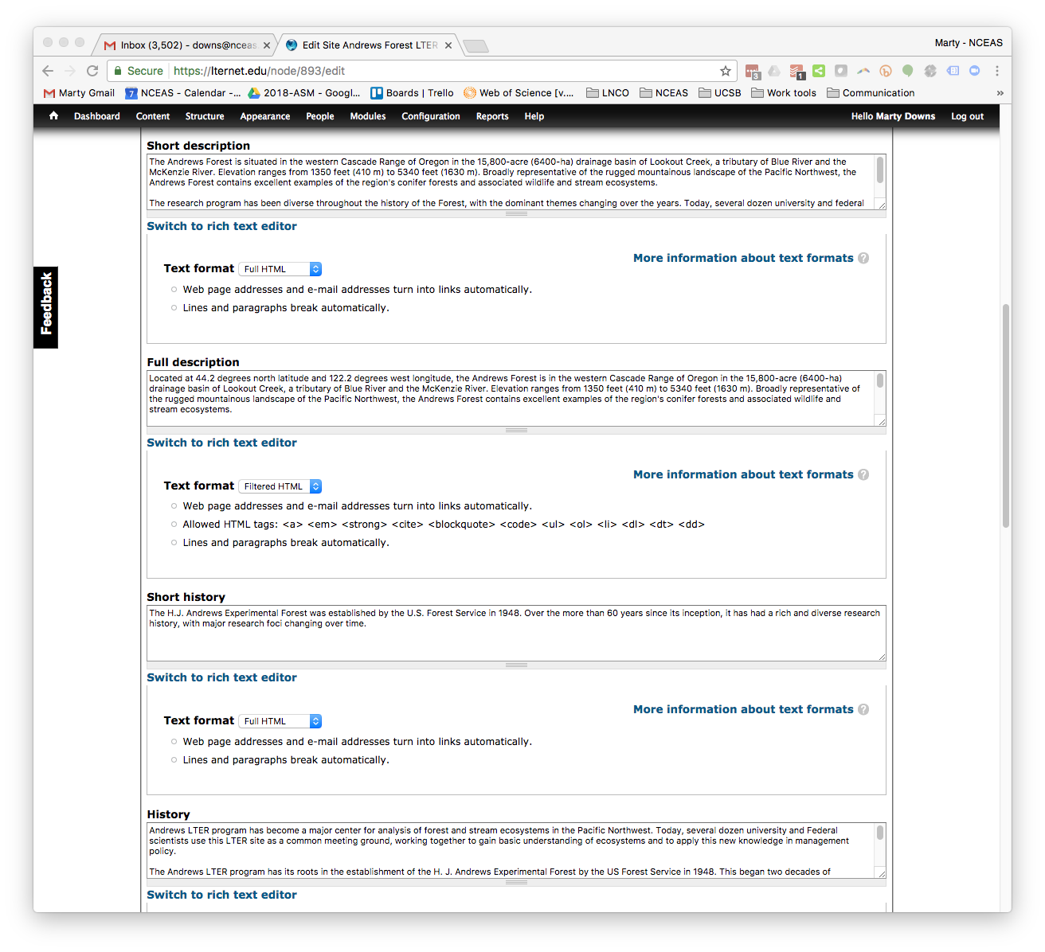
Focus on information architecture

Slide 9
Major post (data) types
Sites
People
Key findings (stories)
Announcements
Events
Opportunities
Images
Documents

Slide 10
The Network | Research | Education | Science for Decisions | Media
Vision/mission
History
Sites
Network Organization
NCO
Science Council/EB
Standing Committees (IM, Education, Publications, Communications, Diversity, Graduate)
Current Projects
Diversity Plan
Contact Us
Directory
images

Slide 11
The Network | Research | Education | Science for Decisions | Media
How we work
Observation
Experiments
Modeling
Synthetic Science
Partnerships
LTER data resources
Core Themes
Current Working Groups
Past Working Groups
Synthesis RFPs
Grad/postdoc opportunities

Slide 12
The Network | Research | Education | Science for Decisions | Media
Undergraduate
Data literacy
REU Opportunities
K-12
Schoolyard LTERs
Data Literacy
Data Jams
Classroom Resources
Data Nuggets
RET Opportunities
Education Resources (EDL)
Informal/Stakeholder
Schoolyard Book Series
Site Tours
Activities by site

Slide 13
The Network | Research | Education | Science for Decisions | Media
Agency Partnerships
Scenarios
Modeling
Stakeholder Engagement

Slide 14
The Network | Research | Education | Science for Decisions | For the Media
LTER in the News (news about us)
Research News (news from us)
LTER Science Update (signup also on home page)
Social Media (also integrated throughout)
Image Gallery
Expert Database

Slide 15
Internal
Committee Documents (may require login) | Executive Board
 | Science Council
 | Information Management
 | Education & Outreach
 | Other
LTER Organization (no login required) | 10-year Reviews
 | Planning Documents
 | Bylaws
 | Surveys
 | All-Scientists Meetings
Publications (no login required) | Books
 | Brochures
 | Annual Reports
 | Newsletters
Working Group Reports (no login required) | by year
Conferences (no login required) | by year
Presentations (no login required) | by year

Slide 16
The Network | Research | Education | Science for Decisions | Media
Vision/mission
History
Sites
Network Organization
NCO
Science Council/EB
Standing Committees (IM, Education, Publications, Communications, Diversity, Graduate)
Current Projects
Diversity Plan
Contact Us
Directory
images

